Slide 1




mini project 2 BAN 5753
BY-
Hayden Myers
Kumar Yash
Anuj Pratap Singh
Chhavi Nijhawan

Slide 2
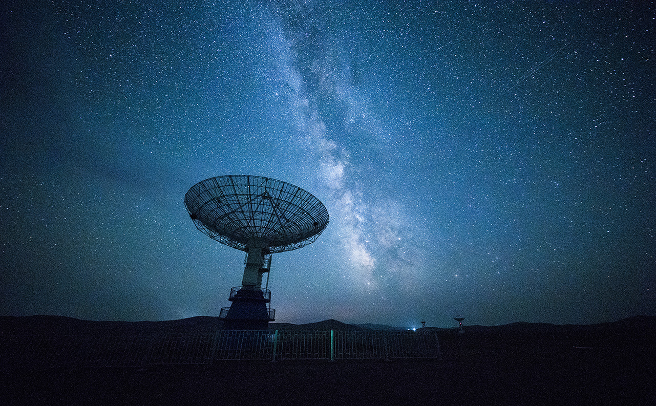
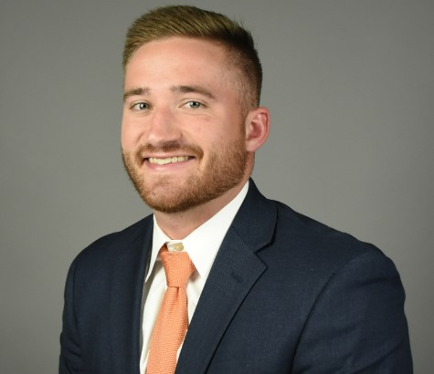
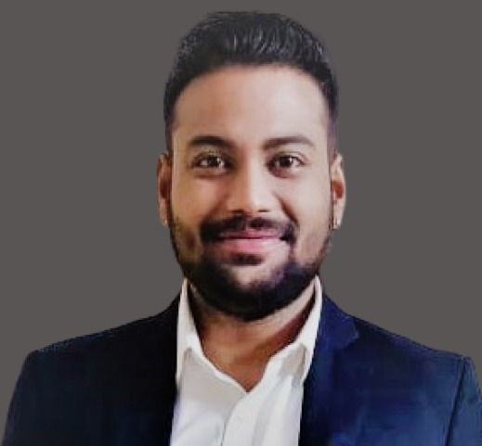

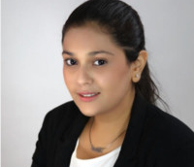
The Team
Hayden Myers
Kumar
Yash
Anuj Pratap Singh
Chhavi
Nijhawan

Slide 3


Table of Contents
Problem Statement
Exploratory Data Analysis
Predictive Models
K-means Clustering
Best Model Evaluation
Conclusion
Data
Linear SVC
Prescriptive Recommendations

Slide 4

Problem statement
Identification of clients who will subscribe for a term deposit through classification modeling.

Slide 5

DATA
Dataset: XYZ_Bank_Deposit_Data_Classification.csv
Rows: 411,89
Columns: 20
Time Range: May 2008 – November 2010

Slide 6

Exploratory Data Analysis
The aim of the EDA conducted was to:
Identify relationships between variables
Variable distribution analysis
Distinguish between categorical and numerical attributes
Null values identification
Evaluating cardinality for the categorical variables
Evaluating summary statistics for numeric variables
Evaluating number of distinct and null values for attributes
Evaluating model accuracy and performance

Slide 7
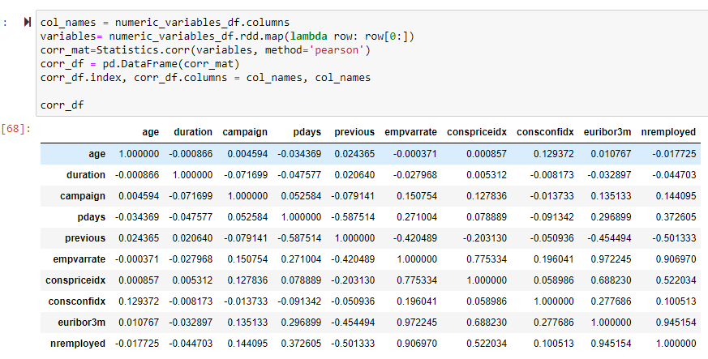
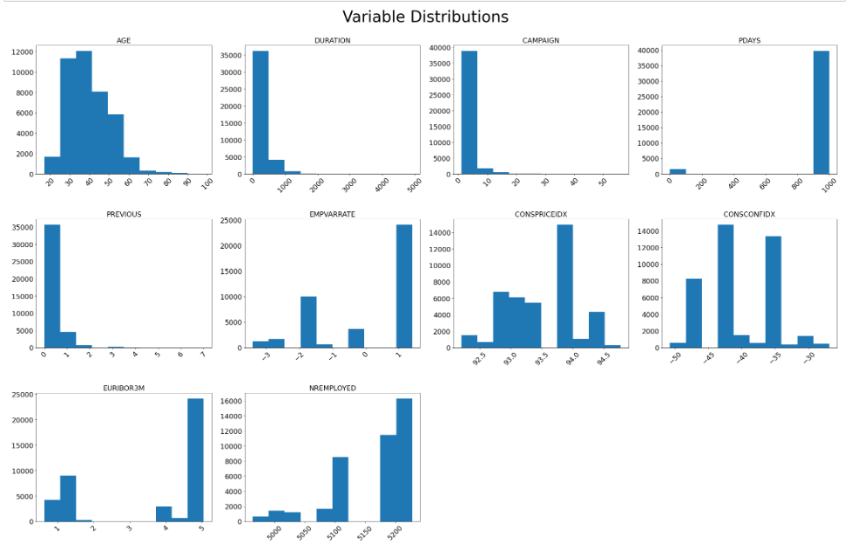
Pearson correlation & Variable distribution Plots

Slide 8
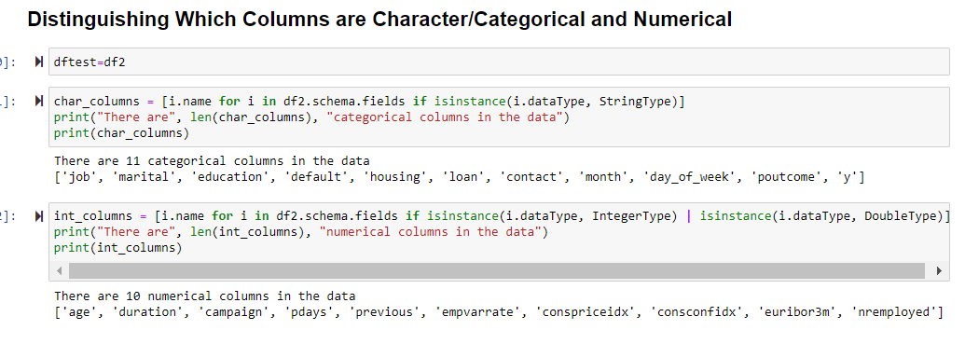
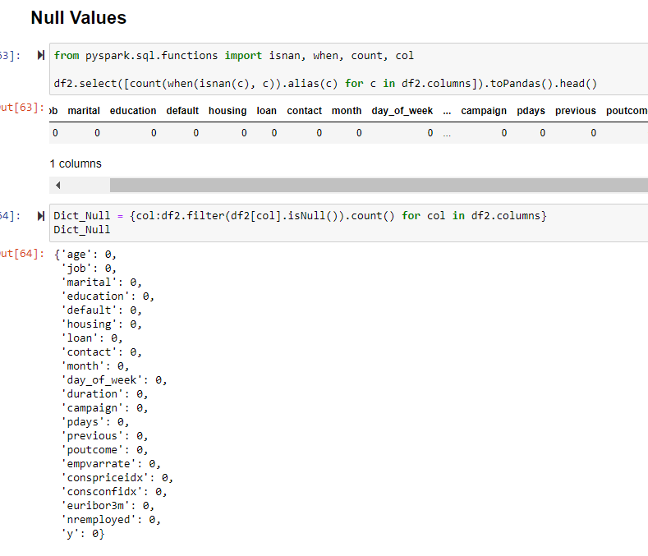
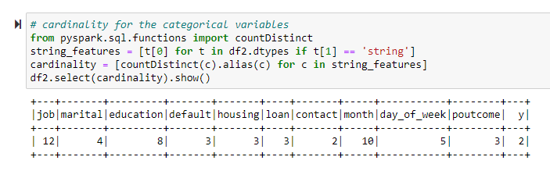
Attributes distinction, Null Values & cardinality

Slide 9
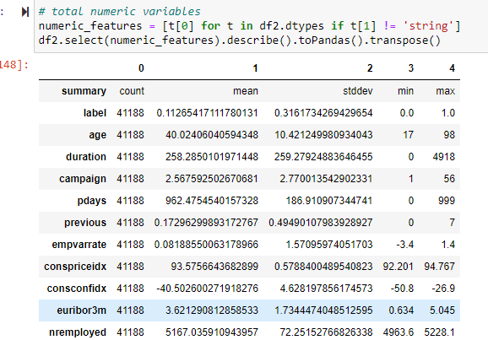
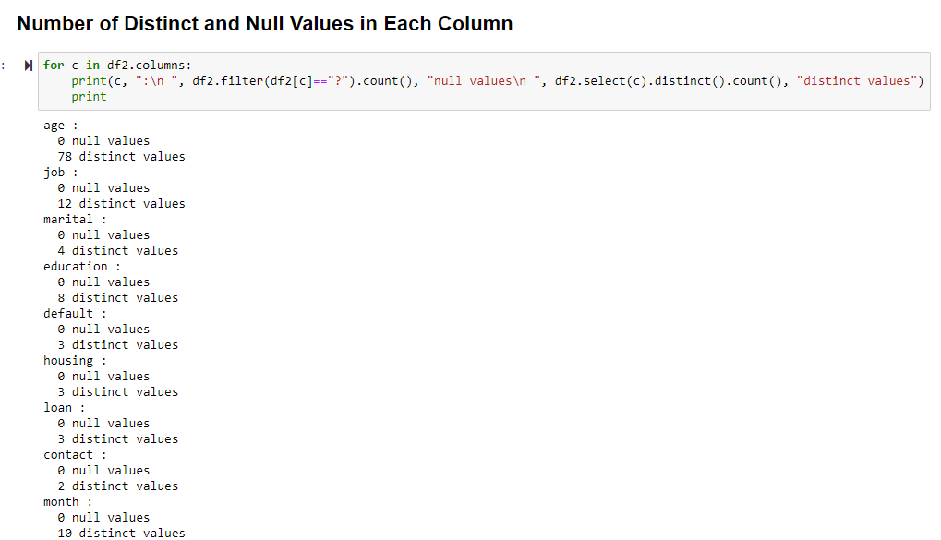
Variables Statistics & number of null & distinct values

Slide 10

Predictive models
Logistic Regression
Decision Tree
Random Forest
Gradient Boosted Tree Classifier
K-Means
Linear SVC

Slide 11
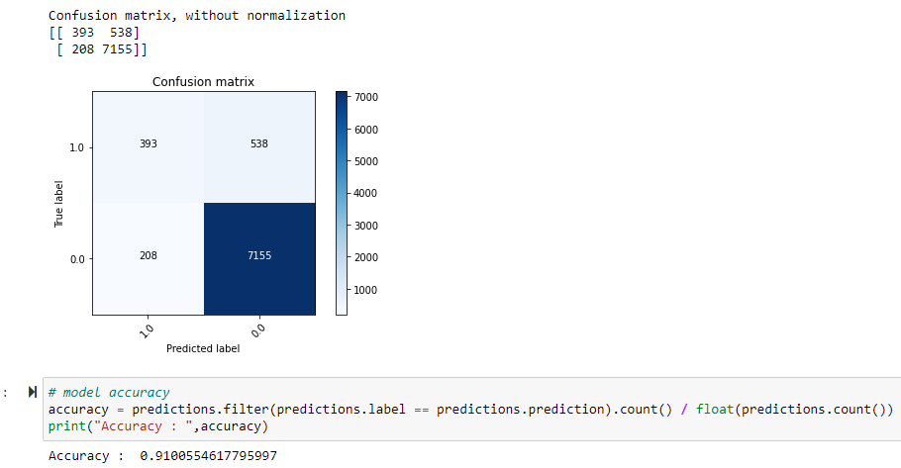
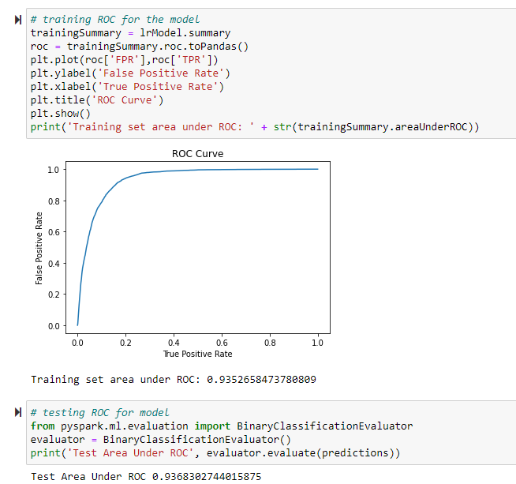
Logistic Regression results
Accuracy: 91.005%
Testing Area Under ROC: 93.68%

Slide 12
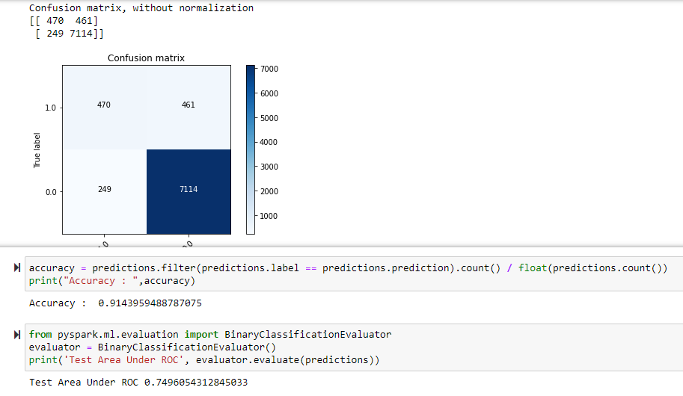
Decision tree Results
Accuracy: 91.43%
Testing Area Under ROC: 74.96%

Slide 13
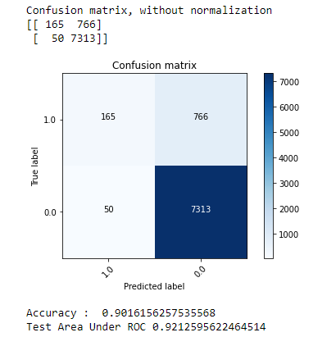
Random Forest Results
Accuracy: 90.16%
Testing Area under ROC: 92.12%

Slide 14
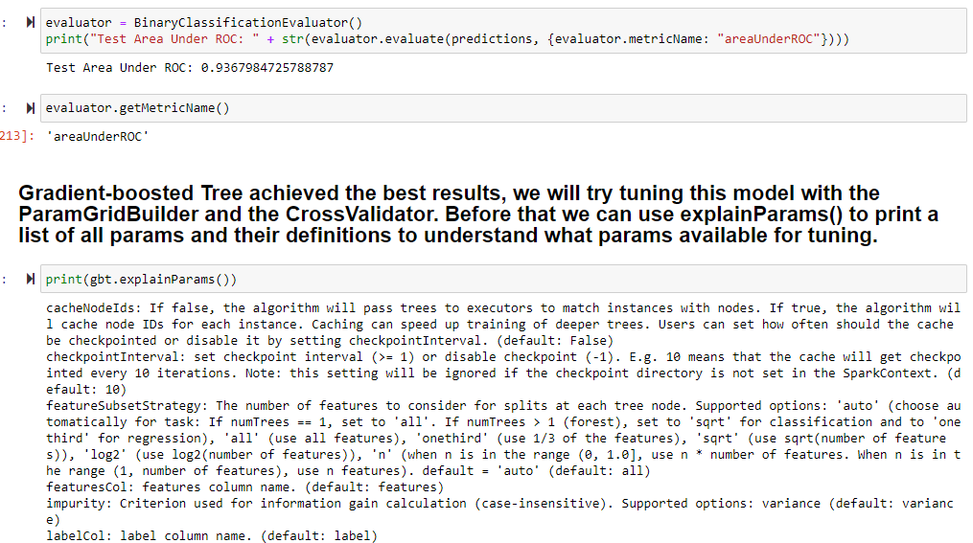
Gradient Boosting Tree Results
Testing Area under ROC: 93.67%

Slide 15
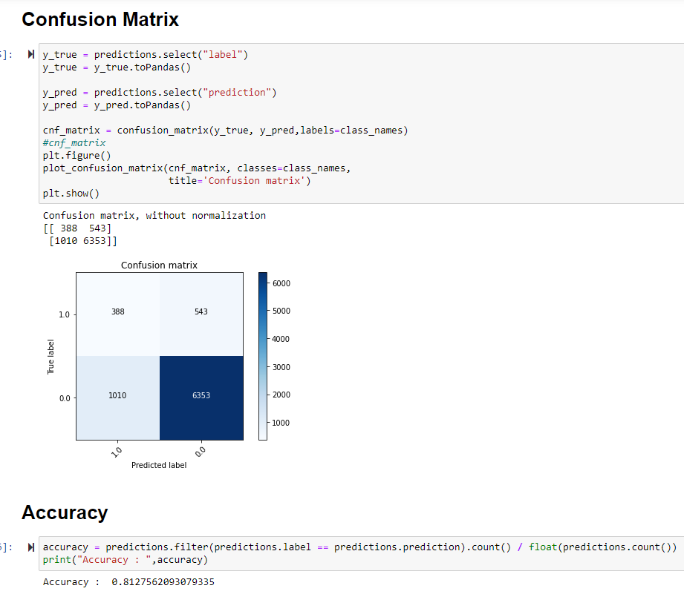
K-MEANS CLUSTERING
Accuracy: 81.27%
Test Area under ROC: 92.12%

Slide 16
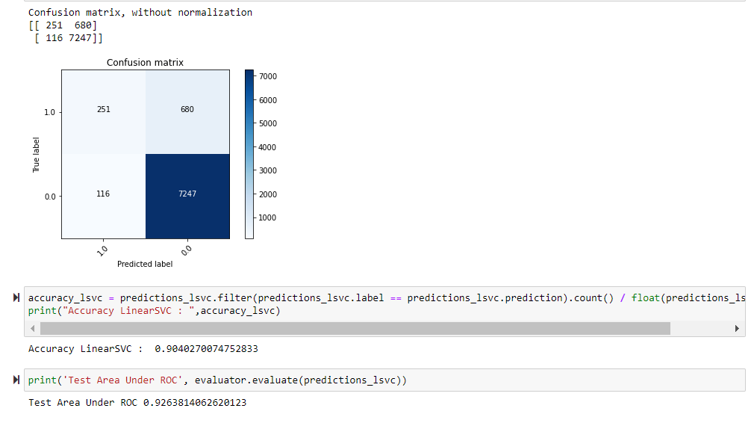
Linear SVC
Accuracy: 90.40%
Test Area under ROC: 92.63%

Slide 17
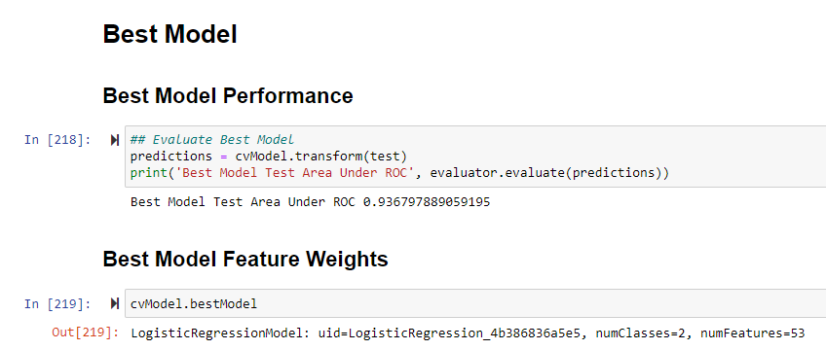
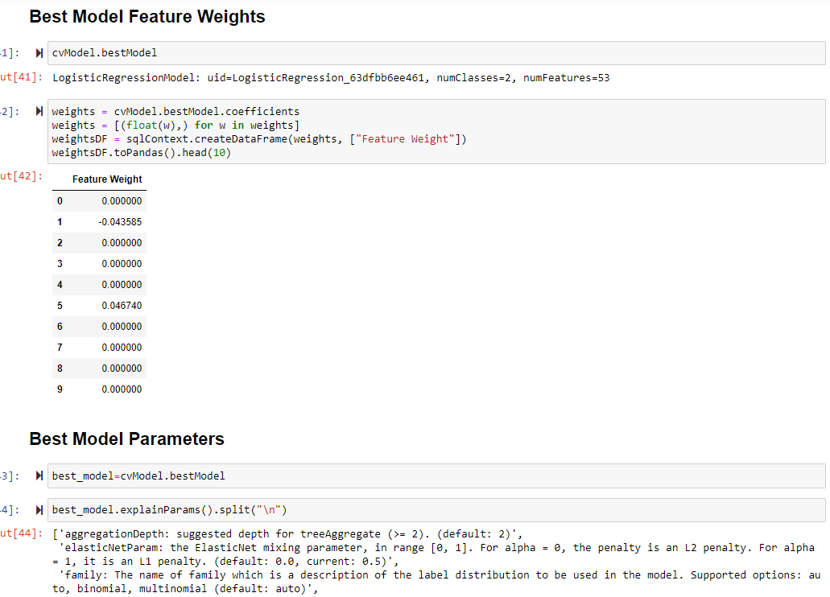
Best model evaluation
Logistic Regression comes out to be the best performing model amongst all.

Slide 18

Prescriptive Recommendations
Offer more ads to the people that were correctly predicted to subscribe for term deposits
Example: send frequent e-mails, text messages etc.
Give future clients a deal on deposits who are already subscribed and those who are willing to in the future to draw in more business.
With people who are correctly predicted to not come and use the term deposits, ask them in a questionnaire what could be improved to get their business.
Use social media to push a campaign for the term deposits to broaden the scope of potential clients/customers.

Slide 19





Conclusion
High values for AUC for almost all models
Logistic Regression leads amongst all the models
Decision Tree did not work as well as anticipated, the AUC was quite low even though accuracy was high.
K-Means had lowest accuracy (82%) and with two clusters in it

Slide 20

Thank You!
You can reach us at:
● hmmyers@okstate.edu
● kumar.yash@okstate.edu
● anuj.singh@okstate.edu
● chhavi.nijhawan@okstate.edu

